Slide 1
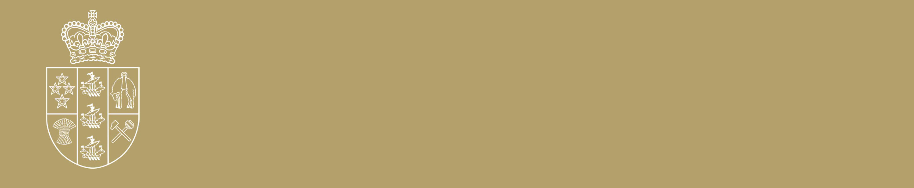
He manukura whenua,
He manukura tangata
Notes:
The first part He manukura whenua links the people to the land and the land to the people. The second part He manukura tangata literally translates to a leader of people from more well-known figures to community leaders doing valuable work who may be less in the public eye.

Slide 2
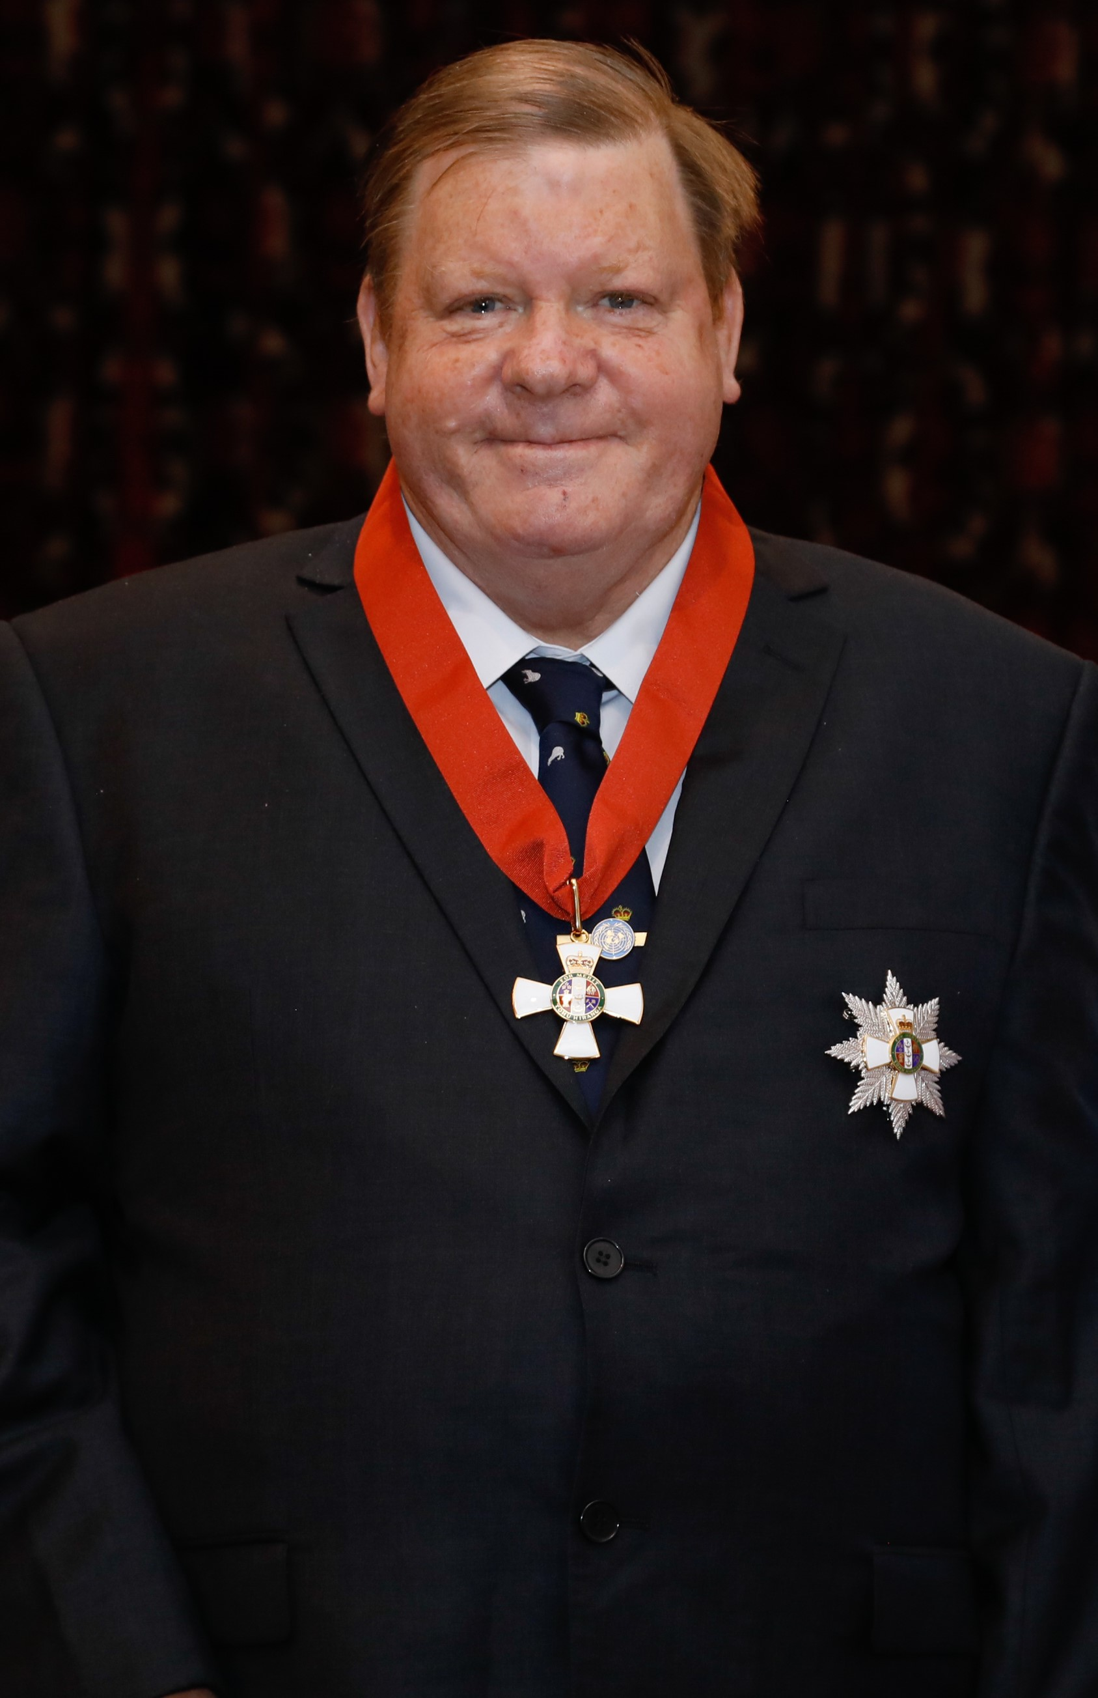
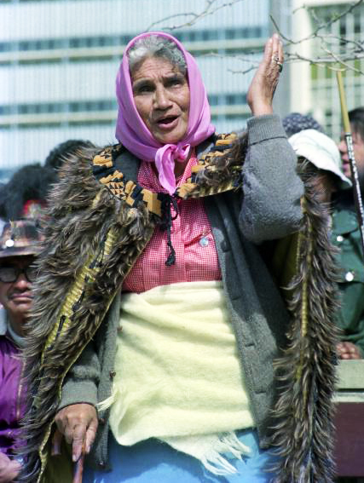
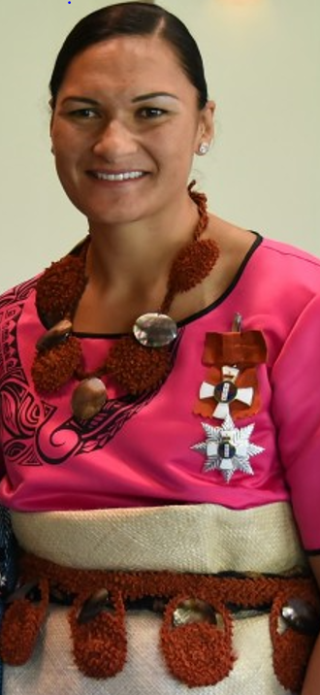
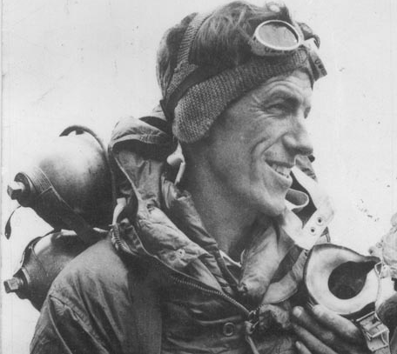
Inspirational Kiwis
Manukura
Exploring the New Zealand Royal Honours system and recipients
Notes:
Brainstorm some inspirational New Zealanders that the students are familiar with (can choose to do this as whole class or in small groups). We have provided some case studies of several amazing New Zealanders who have been knighted – feel free to use your own relevant examples. Good books to have copies of if possible include: Go Girls, Oh Boy and Kia Kaha. There are individual books about New Zealand heroes such as First to the top by David Hill. Explore New Zealanders who have received/been nominated for Royal New Zealand Honours – but also consider those who have not and why not? Look at historical figures too (e.g. and research someone who you think deserved acknowledgement.) See Teaching Unit for more details.

Slide 3
What is New Zealand’s highest honour?
Notes:
The first part He manukura whenua links the people to the land and the land to the people. The second part He manukura tangata literally translates to a leader of people from more well-known figures to community leaders doing valuable work who may be less in the public eye.

Slide 4
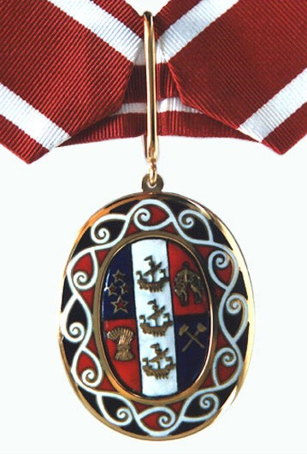
The Order of New Zealand
On Waitangi Day 1987 the Order of New Zealand became New Zealand’s most senior honour.
Current members of the order include: Joy Cowley, Dame Kiri Te Kanawa, Helen Clark, Sir Peter Gluckman.
Three former Governors-General have been made members of the order: The Honourable Dame Silvia Cartwright, ONZ, PCNZM, DBE, QSO, DStJ (made an Additional Member in June 2022), The Right Reverend & The Honourable Sir Paul Reeves, ONZ, GCMG, BCVO, QSO and The Honourable Dame Catherine Anne Tizard, ONZ, GCMG, GCVO, DBE, QSO.
Deceased members include: Dame Whina Cooper, Sir Edmund Percival Hillary and Margaret Mahy.
Children's author Joy Cowley awarded Order of New Zealand in week of accolades | Stuff.co.nz
Notes:
For more information about The Order of New Zealand: https://dpmc.govt.nz/our-programmes/new-zealand-royal-honours/new-zealand-royal-honours-system/components-new-zealand-1

Slide 5
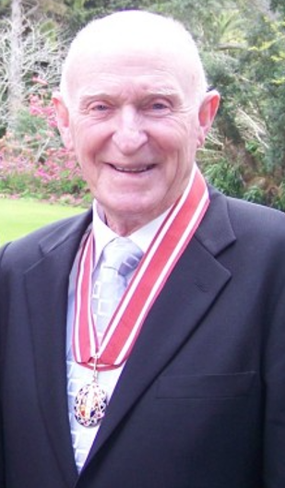
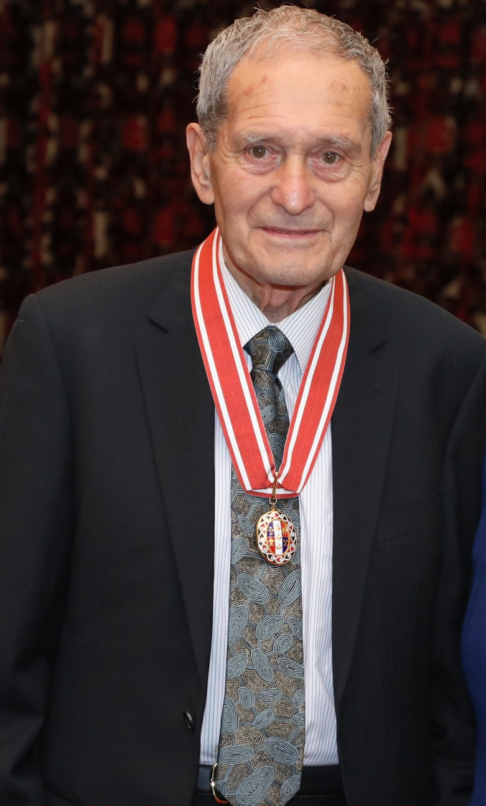
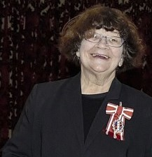
Some members of the order of New Zealand
Sir Murray Halberg
Dame Joy Cowley
Sir Mason Durie
Notes:
Sir Mason Durie (Inspirational Māori leader in fields of mental health, Māori health and wellbeing and Professor of Māori studies) , Sir Murray Halberg (Olympic champion and founder of the Halberg Foundation, which supports physically disabled New Zealanders to participate in sport and recreation) , and Dame Joy Cowley (celebrated children’s author and literacy specialist).

Slide 6
Dame
Whina Cooper
Member of the Order of New Zealand (ONZ), and Dame Commander of the Order of the British Empire (DBE)
Māori leader and activist
Notes:
In 1990 awarded New Zealand 1990 Commemoration Medal. 1991: was appointed to the Order of New Zealand (New Zealand’s highest civil honour)
1993: awarded New Zealand Suffrage Centennial Medal.
Even from a young age Dame Whina found ways to help her community. She was a teacher at Pawarenga Native school. She took part in a protest to stop farmers draining a swamp Māori used to gather seafood whenever it flooded. She was skilled in getting people to work together. She was a leader in land development. First president of Women’s Welfare League. When the Queen awarded Whina a medal she said: “I am the wearer to show that if some can get to these heights, we all can”. Most famously she led Te Ropu o te Matakite, to protest more land loss. A protest march 10,000 kms from Te Hāpua in the Far North to Parliament in Wellington. Her message was always that the nation should be united. Dame Whina Cooper biopic out in June aligning with the inaugural New Matariki public holiday. Whina (nzfilm.co.nz)

Slide 7
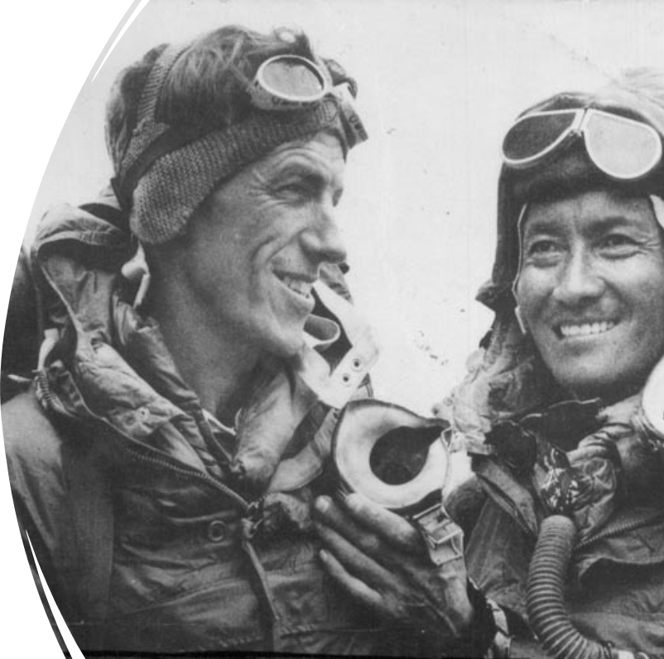
Sir
Edmund Hillary
Knight of the Order of the Garter (KG), Member of the Order of New Zealand (ONZ), and Knight Commander of the Order of the British Empire (KBE).
Mountaineer, adventurer and philanthropist
Notes:
https://dpmc.govt.nz/honours/recipients/hillary-sir-edmund-percival-kg-onz-kbe. Citation included.

Slide 8
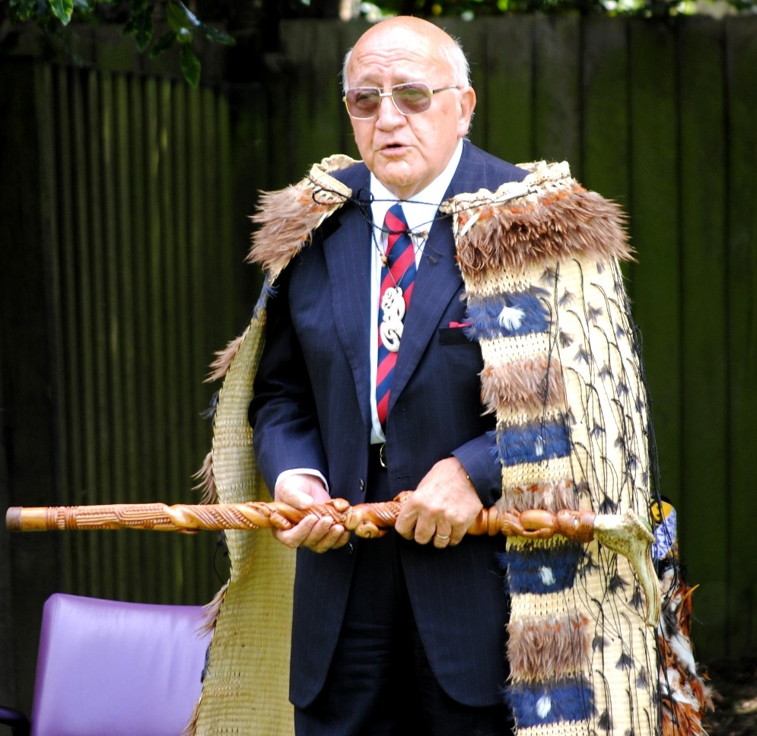
Sir
Tipene O’Regan
Member of the Order of New Zealand (ONZ)
Knight Bachelor
For services to the Māori people and the community
Renowned Māori leader, Academic and Businessman
Notes:
Sir Tipene O’Regan was appointed to the Ngāi Tahu Māori Trust Board in 1976. He was on the board for 22 years and was chair for 13 years.^{[1]} He guided the board to successful land and sea fisheries claims before the Waitangi Tribunal, culminating in the Tribunal's reports of 1991 and 1992. He later led claim settlement negotiations leading to the 1998 settlement which made extensive provision for customary rights in fisheries and other natural resources. He is a director of a wide range of South Island Māori enterprises.
In the 1994 Queen's Birthday Honours, O'Regan was appointed a Knight Bachelor, for services to the Māori people and the community.^{[3]} In 2019 he was made a Companion of Royal Society Te Apārangi.^{[4]}
In 2022 made Kiwibank New Zealander of the Year for his work in Ngāi Tahu’s Treaty Settlement, as an educator and as a public figure whose life has been dedicated to building an inclusive, bicultural nation. He was made an Additional Member of The Order of New Zealand in the 2022 Queen’s Birthday Honours list as part of the Queen’s Platinum Jubilee.

Slide 9
More Inspirational
New Zealanders

Slide 10
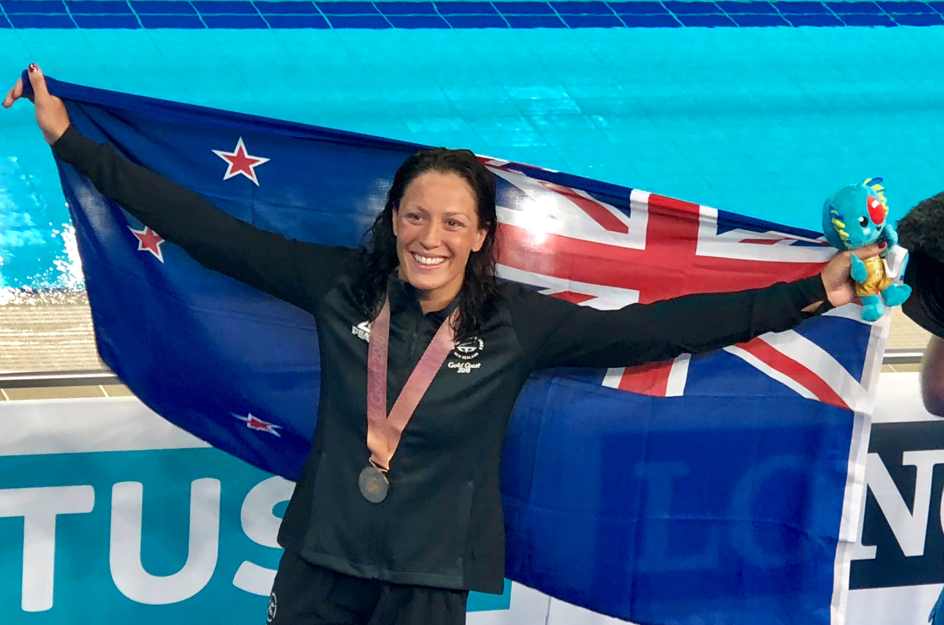
Dame
Sophie Pascoe
Dame Companion of the New Zealand Order of Merit (DNZM) For services to swimming
Eleven-time Paralympic gold medalist and multiple World Swimming Champion
Sophie Pascoe (paralympic.org)
Notes:
Sophie was just two when she lost her left leg below the knee and suffered damage to her right leg in a lawnmowing accident. Despite this she became a champion swimmer – easily beating her able-bodied peers. Aged just 15, Sophie was the youngest member of the New Zealand team at Beijing 2008 where she won three gold and one silver medal in the Water Cube. New Zealand’s most decorated Paralympian.
Photo credit: Dame Patsy Reddy

Slide 11
Sir
Robert Martin
Knight Companion of the New Zealand Order of Merit (KNZM)
For services to people with disabilities
Disability rights activist
Notes:
Citation included

Slide 12
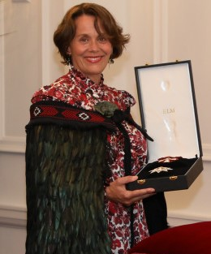
Dame
Hinewehi Mohi
Dame Companion of the New Zealand Order of Merit (DNZM)
For Services to Māori, music and television
Award-winning New Zealand musician and performer
Notes:
The Raukatauri Music Therapy Centre was established in March 2004 by singer and songwriter Hinewehi Mohi, who named it after her daughter Hineraukatauri who has severe cerebral palsy.

Slide 13
Dame
Valerie Adams
Dame Companion of the New Zealand Order of Merit (DNZM)
For services to athletics
Olympic shot-putting Champion
Dame Valerie after winning bronze at 2021 Tokyo Olympics: RNZ Audio Player
Notes:
Citation included

Slide 14
What traits do these people share?
01
02
03
04
Determination: the ability to keep going even when things are difficult
Caring for people and the land
Desire to pass on their knowledge/skills to the next generation
The ability to unite people
Notes:
What qualities do all these inspirational New Zealanders share? How are they inspirational? Either in their chosen careers or beyond their careers e.g. in the way they have served their country, overcome obstacles etc. E.g. Care for others, stand up for people’s rights, protect the planet, called to do the ‘right’ thing, look after people, inspire other people etc.
Students given time to think of answers and collate answers – one group member is notetaker another is reporter. Bring group back together and reporter shares the qualities. Create a class list of inspirational New Zealanders. Students go on to choose one to research and present to class (see teaching unit notes for more details).

Slide 15
Research an inspirational New Zealander (past or present) and present to your class
Present your research as a PowerPoint, speech, short film, poster etc
Who is your chosen person?
What qualities do they show that make them inspirational?
What achievements are they known for?
Have they received a New Zealand Royal Honour?
If not, think about why they deserve one
Then
Notes:
Students could also consider how their chosen person demonstrates te ao Māori values e.g. manaakitanga, tuakana teina (example of Valerie Adams coaching her sister for Paralympics) etc. This is an interesting list to consider (from 2005 so would definitely be different today – but could prompt discussion about who is on list and who isn’t and why that might be – could possibly come up with own class list or change ranking). New Zealand's Top 100 History Makers - Wikipedia

Slide 16
Celebrating community heroes
The King’s Service Order
Notes:
The King’s Service Order and Medal recognises voluntary service to the community, and service through elected and appointed office. Both the Order and Medal are for civilians only and military service is not eligible.

Slide 17
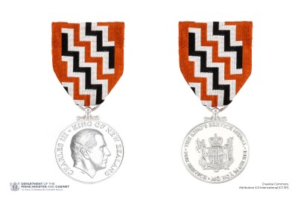
A King’s Service Medal recipient:
CLARKE, Mrs Robin Florence
For services to the community
Mrs Robin Clarke has served her community in various capacities since the 1970s.
As a member of a Palmerston North Save the Children Fund fundraising group, in 1972 Mrs Clarke instigated and solely ran a weekly neighbourhood vegetable stall from her carport, donating all proceeds. In the 1980s and 1990s, she sponsored several refugee families arriving in New Zealand from Cambodia and Somalia, helping them settle into their new country. She accompanied refugees to appointments, supported the creation of connections in the community and regularly checked in with the families. She has been involved with a range of church, friendship and community groups. She was a volunteer facilitator for the Heart Foundation’s ‘Stop Ourselves Smoking’ campaign from 1995 to 1998, planning and tutoring classes to help participants with smoking addiction. From 2001 to 2003, she played a key role in catering the fortnightly meals held by local churches in Ōtaki for those seeking meals and companionship. She has hosted meetings of prayer groups in Wellington and Waikanae and has been active in the Friendship Force movement. Since 2005 Mrs Clarke has been a volunteer driver with the Cancer Society in Ōtaki and Kāpiti, continuing to transport patients to and from Kāpiti Coast for treatment at Wellington Hospital, often accommodating last minute timing changes.
Notes:
An example of a King’s Service Medal citation, listing all the ways Mrs Robin Florence Clarke has contributed to her community (more can be found at:New Year Honours 2022 - Citations for the Queen's Service Medal | Department of the Prime Minister and Cabinet (DPMC)) Begin with name, For services to…then what community they contribute to, then list all their achievements/contributions and the impact. See teaching notes for more detail.

Slide 18
Nominate your
community heroes
Nomination form | Department of the Prime Minister and Cabinet (DPMC)
Notes:
Remember not all heroes wear capes! Some examples might be your school caretaker, your teacher or principal, sports coach, parent or sibling, GP. Approx 1.2 million New Zealanders volunteer in some capacity giving us the highest per capita rate in the world. Discuss what a volunteer is and how they contribute to our communities. Discuss examples from students everyday lives.

Slide 19
Write your own citation celebrating your ‘everyday hero’:
Things to consider:
What makes this person special/stand out?
List some of their qualities e.g. determination, kindness
Give specific examples of the mahi they have done for the community
e.g. volunteering to read to students learning English for the first time
How long has their service been?

Slide 20

You are invited to an Investiture Ceremony at Government House, Wellington:
Room 11 Berhampore School
to an Investiture Ceremony
Government House, Auckland
2 July 2024
Please arrive by «Arrival_time»
Dress: Daywear
To Remind – Please present this card and photo identification
on arrival at Government House
Notes:
We can arrange an Investiture Ceremony for your class/school either in-person or virtual ceremony via Zoom (approx15 mins) which could include a virtual tour of the house (approx. 30 mins) We are able to provide further resources to assist if required.

Slide 21
King's Birthday 2024 Wellington Investiture 5 September PM
Notes:
Watch this clip of an Investiture Ceremony held at Government House Wellington. What is special about the ceremony? How is it unique to New Zealand?

Slide 22
The whakataukī used by the Governor-General:
Whāia te iti kahurangi ki te tūohu koe me he maunga teitei.
Seek the treasure you value most dearly: if you bow your head, let it be to a lofty mountain.
Notes:
This whakataukī is on letters sent from the Governor-General, Dame Cindy Kiro, to honours recipients. It reflects the nature of the honours awards as it is about perseverance and endurance. Refusing to let obstacles get in your way while striving to reach your goals.

